Slide 1

Module 9: Migrating Informatica Repository
0/5
Analytics: Advanced Data Warehouse Developer
Notes:
Time: Lecture: 15 – 20 minutes; Labs: 15 – 20 minutes
Intent: To learn to migrate Informatica repository from one environment to another environment.
Flow: Describe the Informatica repository migration process; describe the backup process; review steps to backup a repository; describe the import process; review steps to import a repository
Key Terms:
Repository
Backup
Restore
9

Slide 2
Module Objectives
After completing this module you will be able to:
  Back up a repository
  Restore a repository
  Migrate a repository from one environment to another environment
Why you need to know:
  You need to know how to migrate the entire Informatica repository from one environment to another environment
Notes:
Each objective and “why you need to know” should be stated aloud.

Slide 3
Informatica Repository Migration
Use Informatica backup and restore process to propagate an Informatica repository built and tested in one environment to another environment
  For example, you want to migrate the entire Informatica repository to a test or production environment after development testing is complete in the development environment
Back up and restore an Informatica repository using the Informatica client tool
Notes:
This slide provides an overview of how Informatica’s backup and restore processes can be used to migrate an Informatica repository from one environment to another environment. These processes can also be used to prevent data or ETL development loss due to hardware or software failures.
9

Slide 4
Backing Up the Repository
Use the Repository Server Administration Console to back up a repository
  Saves the Informatica repository in a binary file
    Repository objects
    Connection details
    Code page information
  Stores the backup file in the Repository Server backup directory
  Uses the extension .rep for all repository backups
Notes:
This slide provides an overview of the backup process.

Slide 5
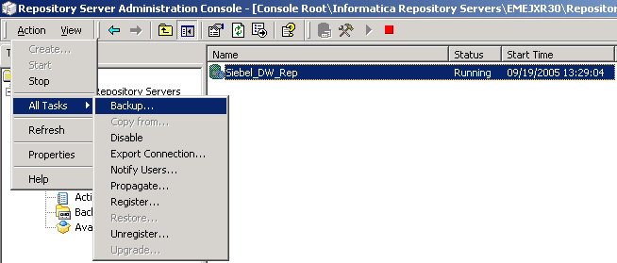
Backing Up the Repository Continued
Select the repository to back up in the Repository Server Administration Console
The repository that needs to be backed up
Notes:
This slide details the process to backup a repository.
9

Slide 6
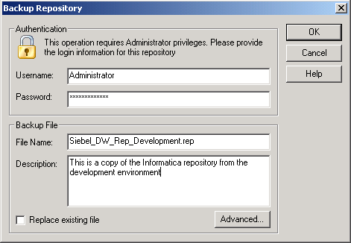
Backing Up the Repository Continued
Specify the user name, password, and file name for the repository backup file
Check this option to overwrite an existing repository backup file
Notes:
Only Administrator or users with Administrator privileges can backup a repository.

Slide 7
Restoring the Repository
Use the Repository Server Administration Console to restore the repository
Restore the repository from the saved repository binary backup file
Restore the repository in a database that has compatible code page with the database from which the backup was made
Notes:
This slide provides an overview of the restore process.
9

Slide 8
Restoring the Repository—Steps
0/7
1. Stop the Informatica service
2. Stop the Informatica repository
3. Delete the repository
4. Restore the repository
5. Start the Informatica repository
6. Start the Informatica service
7. Edit the server and repository properties
Notes:
This is a structuring slide. Do not teach the steps or concepts here because the following slides cover them in detail.

Slide 9
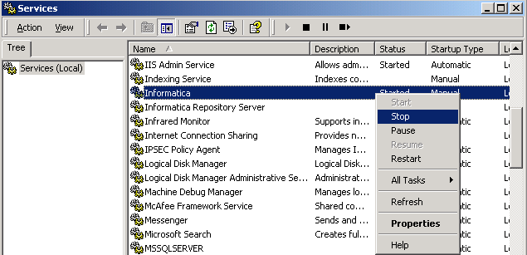
1. Stop the Informatica Service
1/7
Stop the Informatica service before restoring the repository
Notes:
Informatica service requires a live repository and it cannot be running while the restore is in process.
9

Slide 10
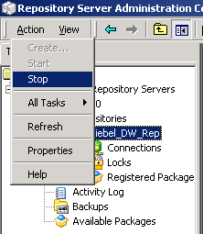
2. Stop the Informatica Repository
2/7
Use the Repository Server Administration Console to stop the Informatica repository
Notes:
The Informatica service needs to be stopped before restoring can begin.

Slide 11
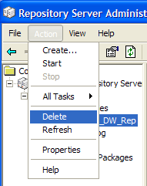
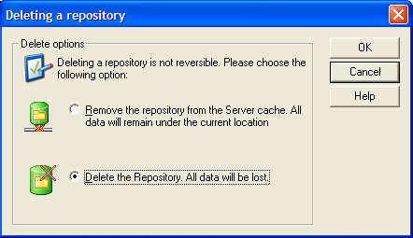
3. Delete the Repository
3/7
Delete the existing repository
  The Repository Server does not restore a repository if one already exists in the target database location
Notes:
This slide details the process to backup a repository.
9

Slide 12
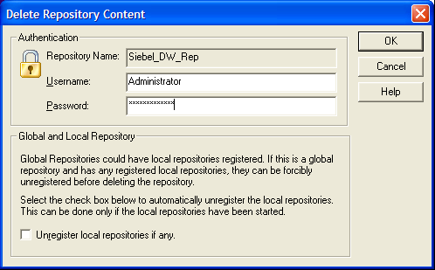
3. Delete the Repository Continued
3/7
Enter the user name and password to confirm the deletion
Notes:
Only Administrator or users with Administrator privileges can delete a repository.

Slide 13
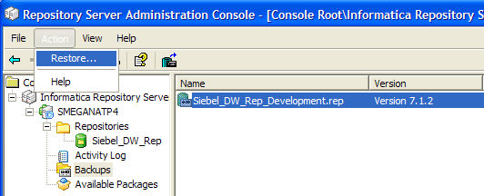
4. Restore the Repository
4/7
Restore the repository from the backed up repository file
Repository to be restored
Notes:
This slide details the process to backup a repository.
9

Slide 14
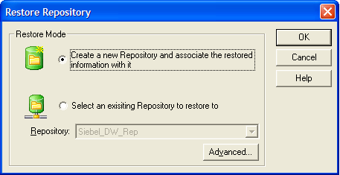
4. Restore the Repository Continued
4/7
Specify new repository configuration for the restore mode
This option creates a new repository
This option associates to an existing repository
Notes:
Since the existing repository was deleted, a new repository is being created during the restore process.

Slide 15
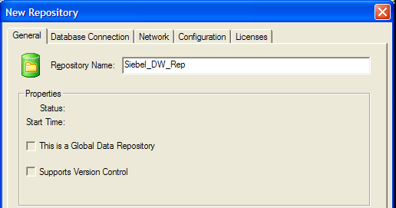
4. Restore the Repository Continued
4/7
Enter the repository name, database connection, and license for the new repository
Enter database, user name, and password details
Enter product and connectivity license keys
Repository name
Notes:
The repository name, database connection, and license details are needed to restore a repository.
9

Slide 16
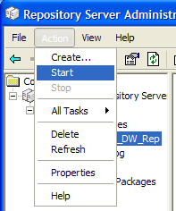
5. Start the Informatica Repository
5/7
Start the Informatica repository in the Repository Server Administration Console
Notes:
The Informatica repository is started before starting the Informatica service.

Slide 17
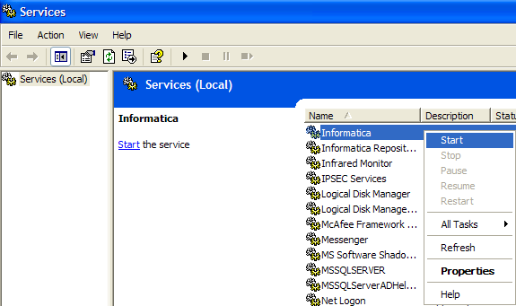
6. Start the Informatica Service
6/7
Start the Informatica service after restoring the repository
Notes:
The Informatica service needs to be running before Informatica client tools can connect to the Informatica server.
9

Slide 18
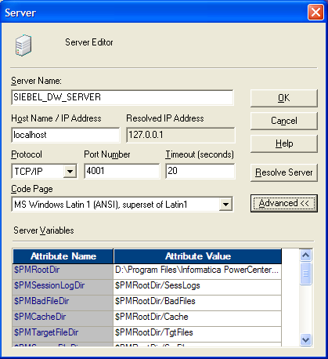
7. Edit the Server and Repository Properties
7/7
Edit the Informatica Server properties in the Workflow Manager
  Specify the hostname and root directory
The hostname is the machine where the repository was exported
The root directory on the environment where the repository was exported
Notes:
The hostname and root directory details are configured to reflect the environment where the Informatica repository is restored.

Slide 19
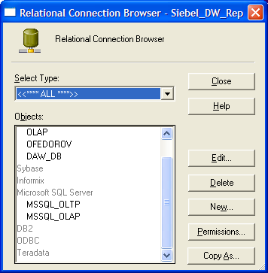
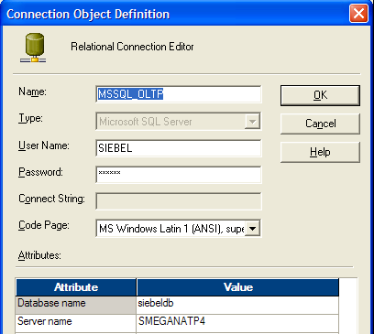
7. Edit the Server and Repository Properties Continued
7/7
Edit the source and target relational database connections
Source database connection details
Source and target database connections
Notes:
The source and target relational database connections are updated to point them to the correct sources and targets.
9

Slide 20
Summary
This module showed you how to:
  Back up a repository
  Restore a repository
  Migrate a repository from one environment to another environment
Notes:
This slide presents a summary of the topics covered in the module.

Slide 21
Lab
In the lab you will:
  Perform steps to back up and restore the Informatica repository using the Repository Server Administration Console
Notes:
Labs and Troubleshooting:
In this lab, students are asked to backup and delete an existing repository and restore the repository from the backed up binary file.
9

